Slide 1
Open Fracture Study Proposal
Megan Johnson, MD
TSRH/CMC

Slide 2
Background
Adult literature clear that open fractures with soft tissue coverage needs should be covered within 7 days – this does not exist in the pediatric literature
Suspect there is variability in how our institutions handle Grade 3B&C open fractures that need coverage and time to definitive coverage
Example – who does flaps (adult vs. peds); ease of getting coverage; who handles washouts/vac changes once bone stabilized, etc.

Slide 3
Previous Work
Reviews:
Pace, J. L. , Kocher, M. S. & Skaggs, D. L. (2012). Evidence-based Review. Journal of Pediatric Orthopaedics, 32 , S123-S127. doi: 10.1097/BPO.0b013e318259f326.
Trionfo A, Cavanaugh PK, Herman MJ. Pediatric Open Fractures. Orthop Clin North Am. 2016 Jul;47(3):565-78. doi: 10.1016/j.ocl.2016.02.003. Epub 2016 Apr 23. PMID: 27241379.
Series of 100ish patients related to ATVs
Torrez TW, Hicks J, Bonner V, Seidenstein AH, McGwin G, Kothari E, Gilbert SR. Increased open fracture complications following pediatric all-terrain vehicle accidents. Injury. 2022 Oct;53(10):3322-3325. doi: 10.1016/j.injury.2022.08.023. Epub 2022 Aug 9. PMID: 36031440.
8 patient case series Grade 3B and C tibia fx
Laine JC, Cherkashin A, Samchukov M, Birch JG, Rathjen KE. The Management of Soft Tissue and Bone Loss in Type IIIB and IIIC Pediatric Open Tibia Fractures. J Pediatr Orthop. 2016 Jul-Aug;36(5):453-8. doi: 10.1097/BPO.0000000000000492. PMID: 25887835.
54 patient retrospective review
Glass GE, Pearse M, Nanchahal J. The ortho-plastic management of Gustilo grade IIIB fractures of the tibia in children: a systematic review of the literature. Injury. 2009 Aug;40(8):876-9. doi: 10.1016/j.injury.2008.12.010. Epub 2009 May 5. PMID: 19419715.
32 patients, retrospective review of prospective database
Messner J, Harwood P, Johnson L, Itte V, Bourke G, Foster P. Lower limb paediatric trauma with bone and soft tissue loss: Ortho-plastic management and outcome in a major trauma centre. Injury. 2020 Jul;51(7):1576-1583. doi: 10.1016/j.injury.2020.03.059. Epub 2020 May 7. PMID: 32444168.
303 patients, single institution retrospective review
Kuhn AW, Troyer SC, Martus JE. Pediatric Open Long-Bone Fracture and Subsequent Deep Infection Risk: The Importance of Early Hospital Care. Children (Basel). 2022 Aug 17;9(8):1243. doi: 10.3390/children9081243. PMID: 36010133; PMCID: PMC9406608.

Slide 4
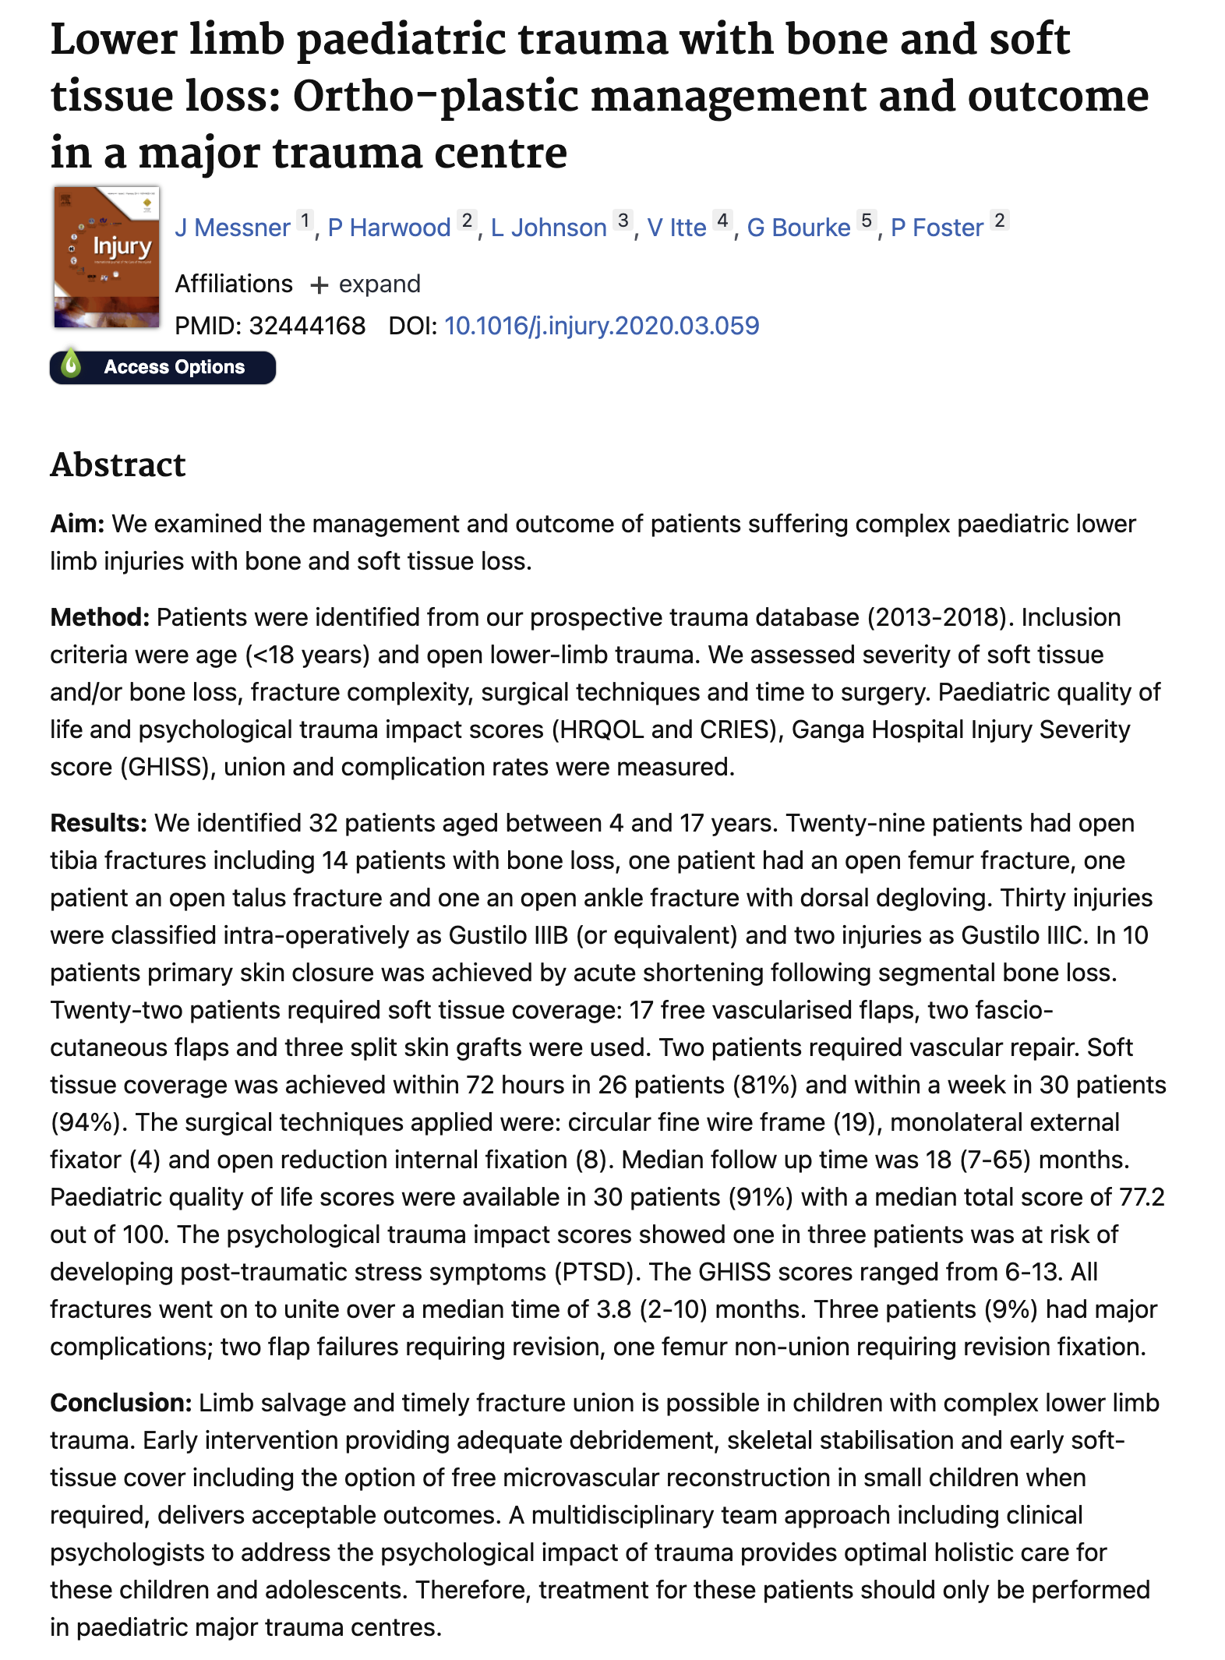

Slide 5
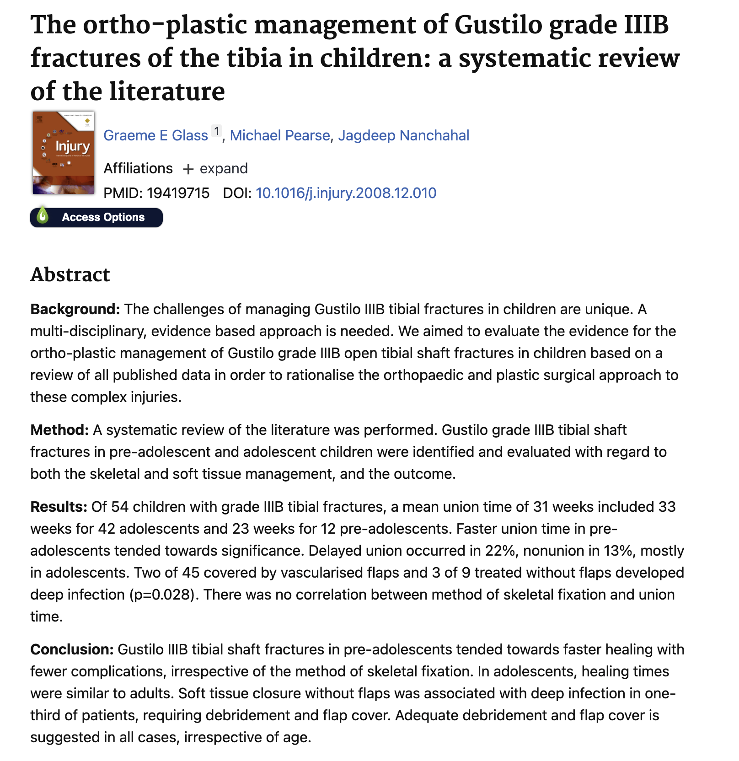

Slide 6
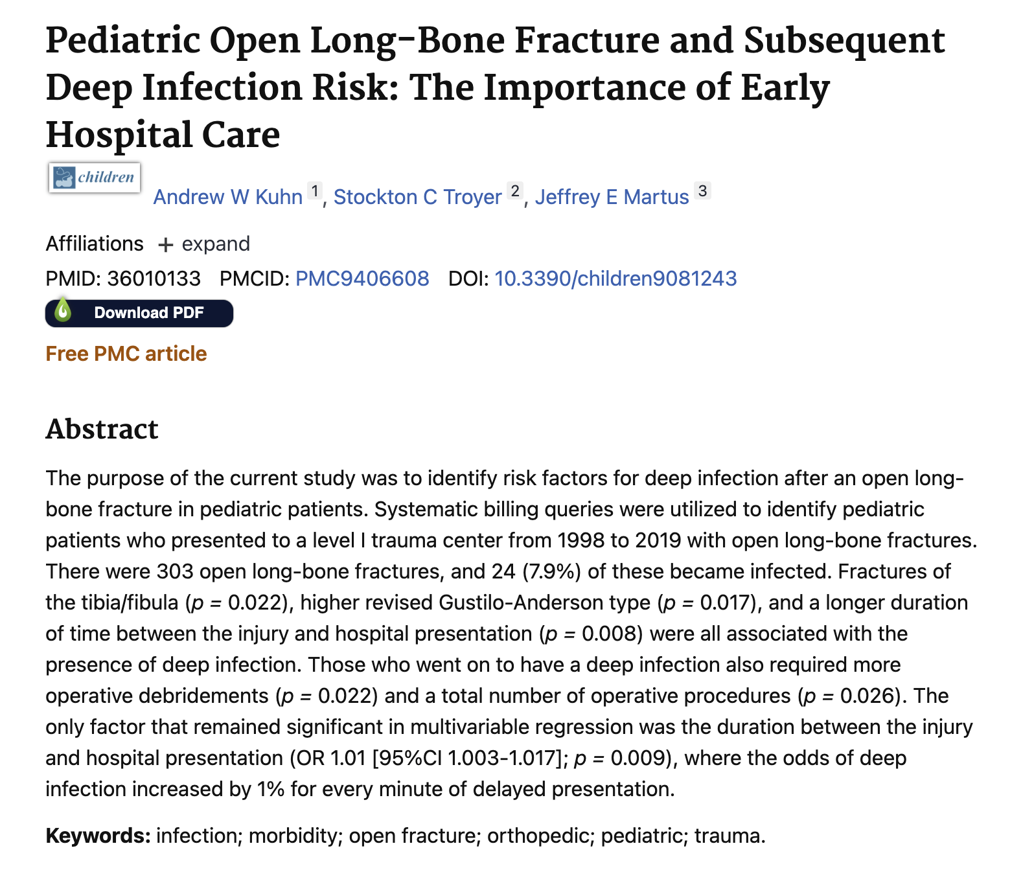

Slide 7
Specific Aims
Primary Aim:
Retrospectively characterize grade 3B&C open fractures in pediatric population with regard to demographics, injury patterns, treatment - bony and soft tissue, and outcome. Hypothesis: there will be significant variability in patterns of soft tissue coverage between hospitals and time to definitive coverage
Primary outcome: time to definitive coverage, ability to and timing of return to activity, complications, need for supervised therapy services, LOS, number of procedures

Slide 8
Specific Aims
Secondary Aims:
To assess the variability in practices for soft tissue coverage of grade B&C open fractures
Hypothesis: There will be significant variation in soft tissue coverage for grade 3B&C open fractures including who does definitive procedures, number of subsequent procedures after bone stabilization, time to definitive coverage

Slide 9
Specific Aims
Secondary Aims:
2. To determine the outcomes of grade 3B&C open fractures in the pediatric population based on location of injury, time to definitive coverage.
Hypothesis: Outcomes in this population will vary based on the location of the injury (and thus the type of coverage needed) and timing to definitive coverage

Slide 10
Design/Methods
Retrospective
0-18, grade 3 open fracture
At least 6 month followup
Exclusion:
Neuromuscular, syndromic, metabolic bone disease
Previous procedures/fracture

Slide 11
Design/Methods
Primary Outcome:
Return to activity (chart review)
Time to definitive coverage (chart review)
Complications (chart review)
LOS, number of procedures (chart review)

Slide 12
Design/Methods
Could broaden hypotheses/questions under same retrospective review of open fractures
Neurovascular injuries (Ben Shore)

