Slide 1
Necrotizing Fasciitis
CORTICES @ POSNA
April 25, 2023
Wendy Ramalingam MD
Stephanie Moore PhD

Slide 2
Background
Rare, life-threatening soft tissue infection with high morbidity and mortality that requires prompt diagnosis and surgical management
Pediatric literature is sparse
Systemic reviews
Small case series

Slide 3
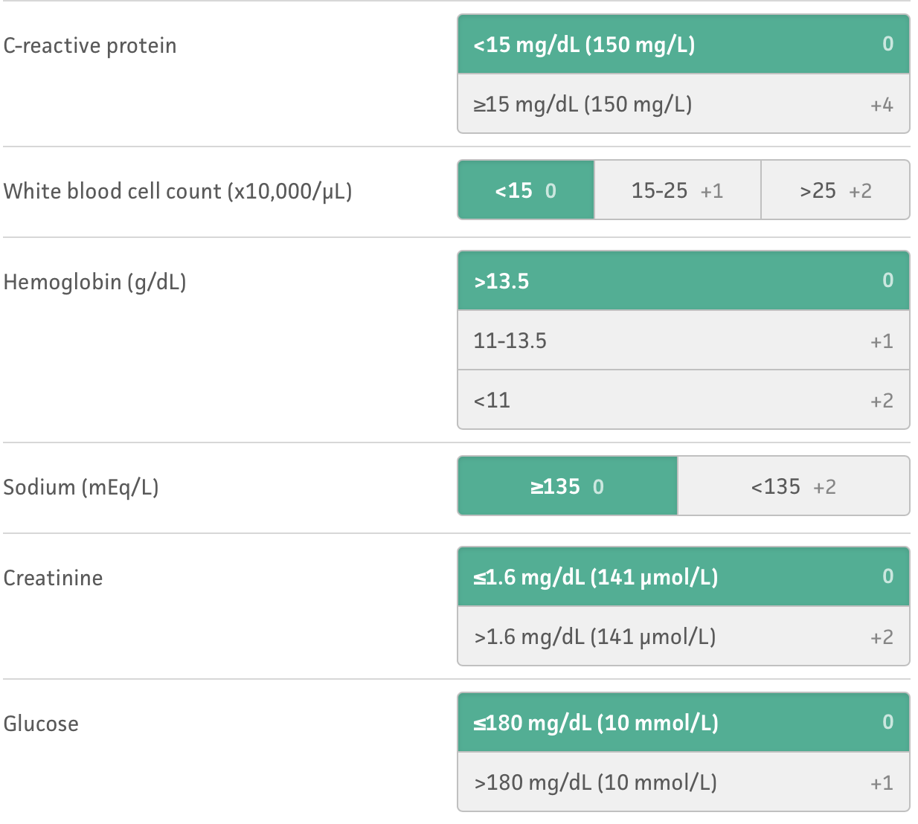
Background
LRINEC (Laboratory Risk Indicator for Necrotizing Fasciitis) score
not validated in pediatric patients
Based on series of 6(!) patients, CRP > 7.0 was 100% sensitive and 95.7% specific for differentiating NF from cellulitis or abscess
NF was associated with thrombocytopenia, hyperthermia, tachycardia, and tachypnea.

Slide 4
Background
Data from recent study at Vanderbilt (Thanks, Stephanie!)
For 23 ped vs adult patients with necrotizing fasciitis:
Similar rates of gender and ethnic distributions were observed
At admission, rate of pain, erythema, and swelling were present at similar rates (via retrospective note review)
The origin of the infection and mechanism of infection were different
Kids experience extremity infection at double the rate of adults (73.9% vs 36.0%)
Kids had much lower rates of NF from infected wounds (0% vs 25.8%)
Kids had higher rates of NF from puncture wounds than adults (17.4% vs 8.1%)
Rate of peritoneum/rectum NF was much higher in adults than in children
The tissue culture rates were markedly different between cohorts
Children had culture-negative NF at more than 5x the rate of adults (23.8% vs 4.6%)
Children with NF had fewer comorbidities than Adults
In adults- rate of comorbidities also correlated with increased mortality
Children had more favorable outcomes with shorter LOS and lower rates of amputation, MODS, and mortality compared to adults
Pediatric mortality (1/23; 4.3%)
Adult mortality (19.8%

Slide 5
Study Aims
Define prevalence and characteristics of necrotizing fasciitis in pediatric patients
Age 0 - 18
January 2010 - June 2020
Determine clinical and laboratory characteristics on presentation for patients with necrotizing fasciitis
Vital signs, CBC, CMP, ESR, CRP
Changes in values over time/admission

Slide 6
Study Aims
Develop pediatric LRINEC scoring system
Use clinical and laboratory characteristics at presentation to differentiate between NF and soft tissue cellulitis/abscess
Case control
Can we qualify the severity and mortality risk via the scoring system?

Slide 7
Study Aims
38 patients at CCHMC with ICD-10 diagnosis of necrotizing fasciitis (M72.6) between July 2010 and June 2020
Tissue/pathology diagnosis
Surgical debridement
Report consistent with necrotizing fasciitis
“dishwater” fluid, positive finger test (easily track along fascia)
1816 cellulitis patients, 1970 abscess patients

Slide 8
Next steps
New IRB?
More than 10 years will need a new IRB

