Slide 1
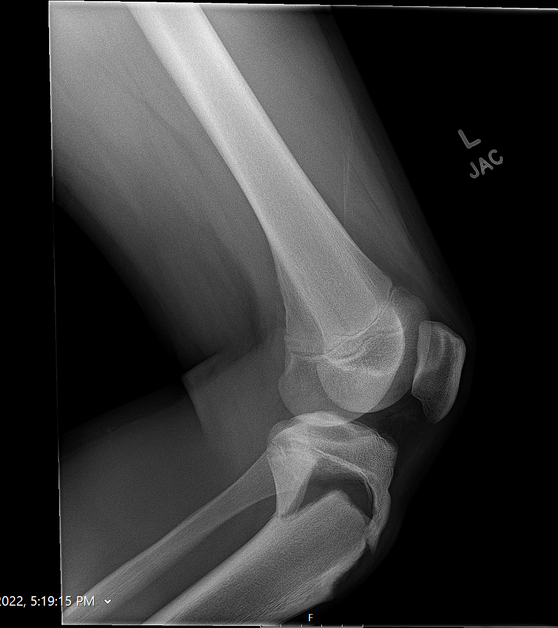
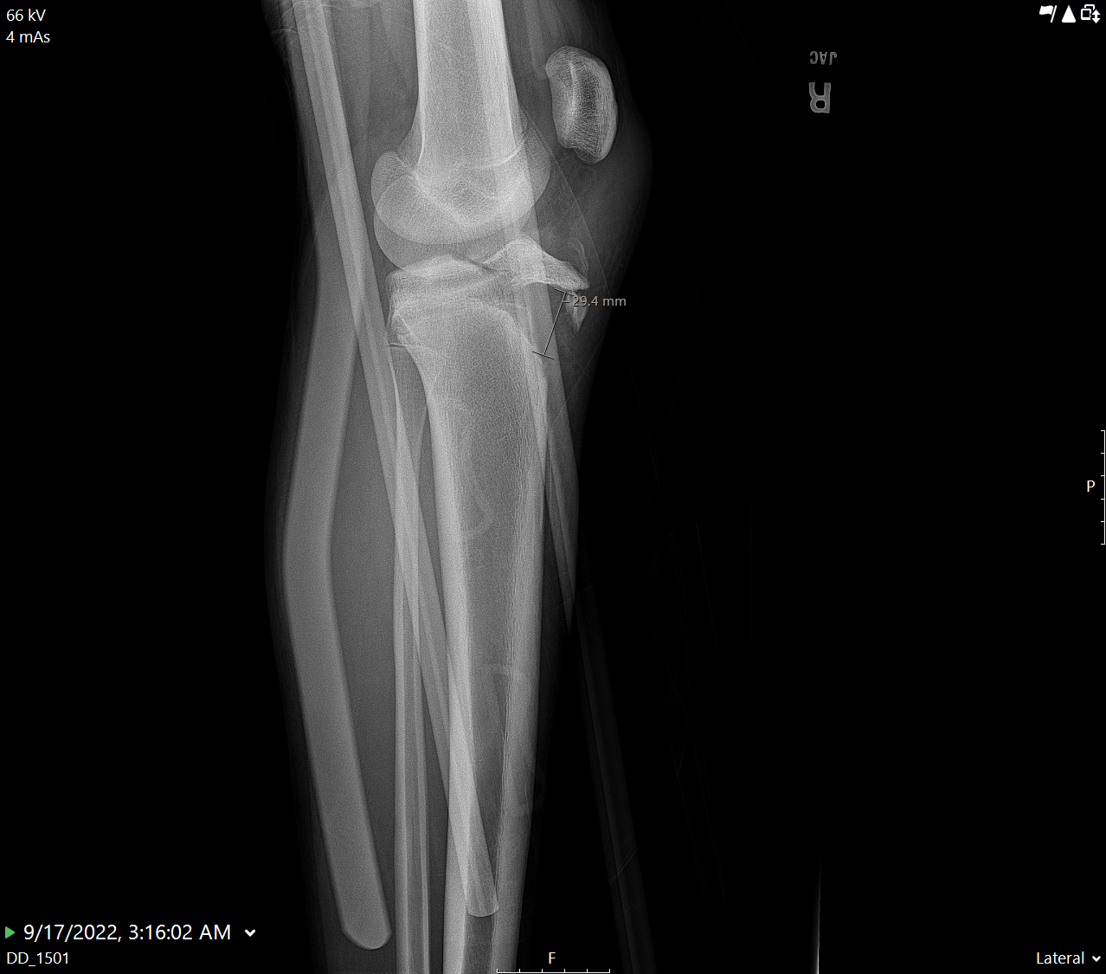
Accelerated Rehab Protocol for Tibial Tubercle Fracture
Nate Lempert
Vanderbilt University Medical Center
CORTICES Meeting November 2022

Slide 2
Literature Review
Traditional recommendations for post op management
Knee immobilizer
Cast
Some have proposed more “aggressive” rehab or accelerated recovery
Significant variability between surgeons
Overall outcomes are excellent in almost all cases
Unpublished retrospective review with 86 cases
0 non-unions, 0 hardware failure, 3 cases of arthrofibrosis
Recent study from CHOP (JPO Oct 2022) cites “99% healing rate, 98% return to full ROM at 22.3 weeks , 94% return to pre-injury level at 28.9 weeks” (Huang, Arkader, Flynn et al.)

Slide 3
Hypothesis
Prior to this recent paper we hypothesized that a more “accelerated rehab protocol” would yield similar or better results
Consecutively enrolled all tibial tubercle fractures
WBAT on POD#0 with hinged knee brace
ROM beginning at 2 weeks
Results:
20 patients
0 hardware failures
0 loss of reduction
100% clearance to return to sport at 3 month visit

Slide 4
Proposal
Multi-Center study
Adopt and implement standardized accelerated protocol
Track outcomes
First published rehabilitation protocol for tibial tubercle fractures
Potentially lower risk of arthrofibrosis with similar excellent outcomes
Advantages:
Easy to implement and teach
Patients and APP’s love it (standardization)
Secondary hypotheses
Compare fixation methods
Rates of hardware removal

Slide 5
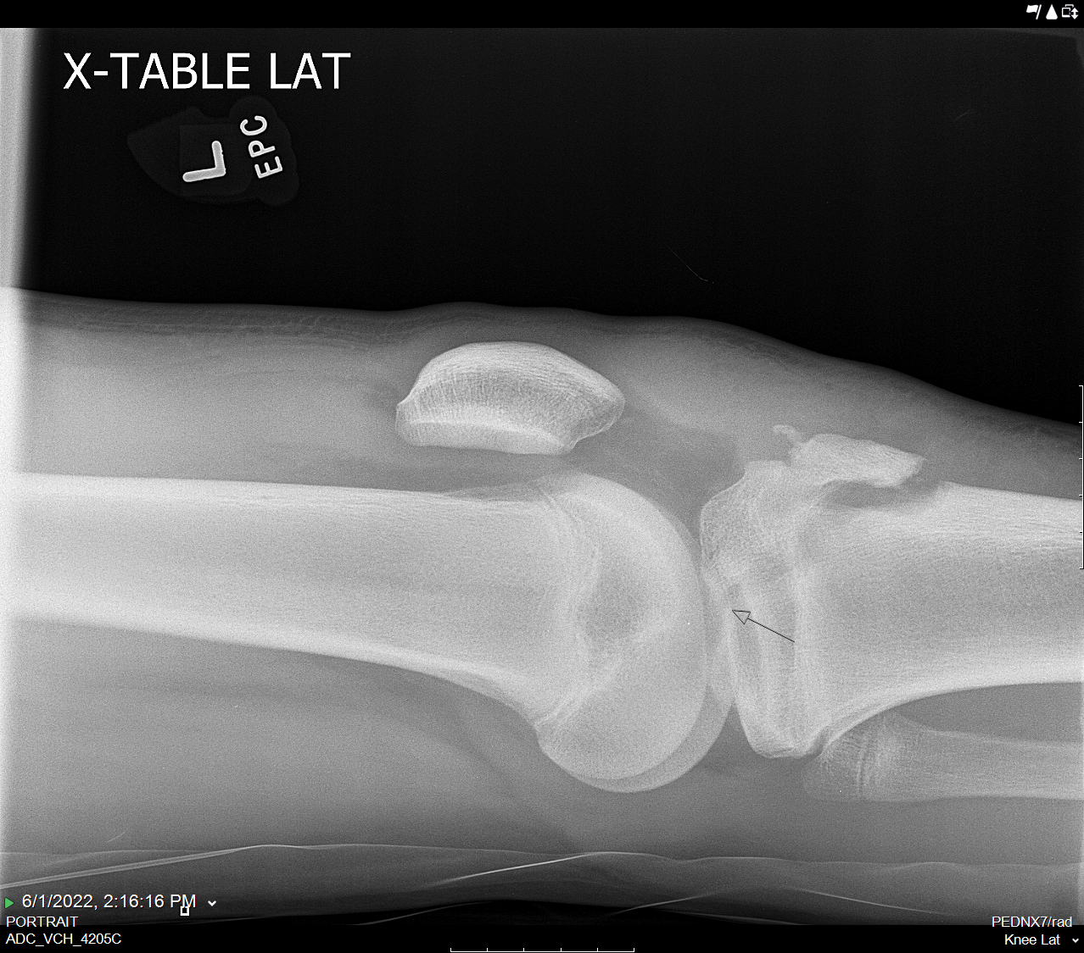
Tibial Tubercle Accelerated Protocol
Tibial Tubercle Accelerated Rehabilitation Protocol
 | WEIGHT BEARING | BRACE | RANGE OF MOTION
PHASE 1 0-2 WEEKS | WBAT (100%) | Worn at all times locked in extension | No passive ROM No active extension out of the brace Goal: full passive extension, no hyperextension
PHASE 2A 2-4 WEEKS | WBAT (100%) | Worn at all times Locked in extension while ambulating | 0-90 passive ROM as tolerated (Brace unlocked while sedentary)
PHASE 2B 4-6 WEEKS | WBAT (100)% | Unlocked 0-90 with ambulation | Full passive ROM as tolerated
PHASE 3 6-12 WEEKS | WBAT (100%) | Wean from brace | Full ROM

Slide 6
Thank you
Nathaniel.Lempert@vumc.org
Cell: 419-344-3993

