Slide 1
Annual CORTICES Meeting
Columbus 2022

Slide 2
20 Sites

Slide 3
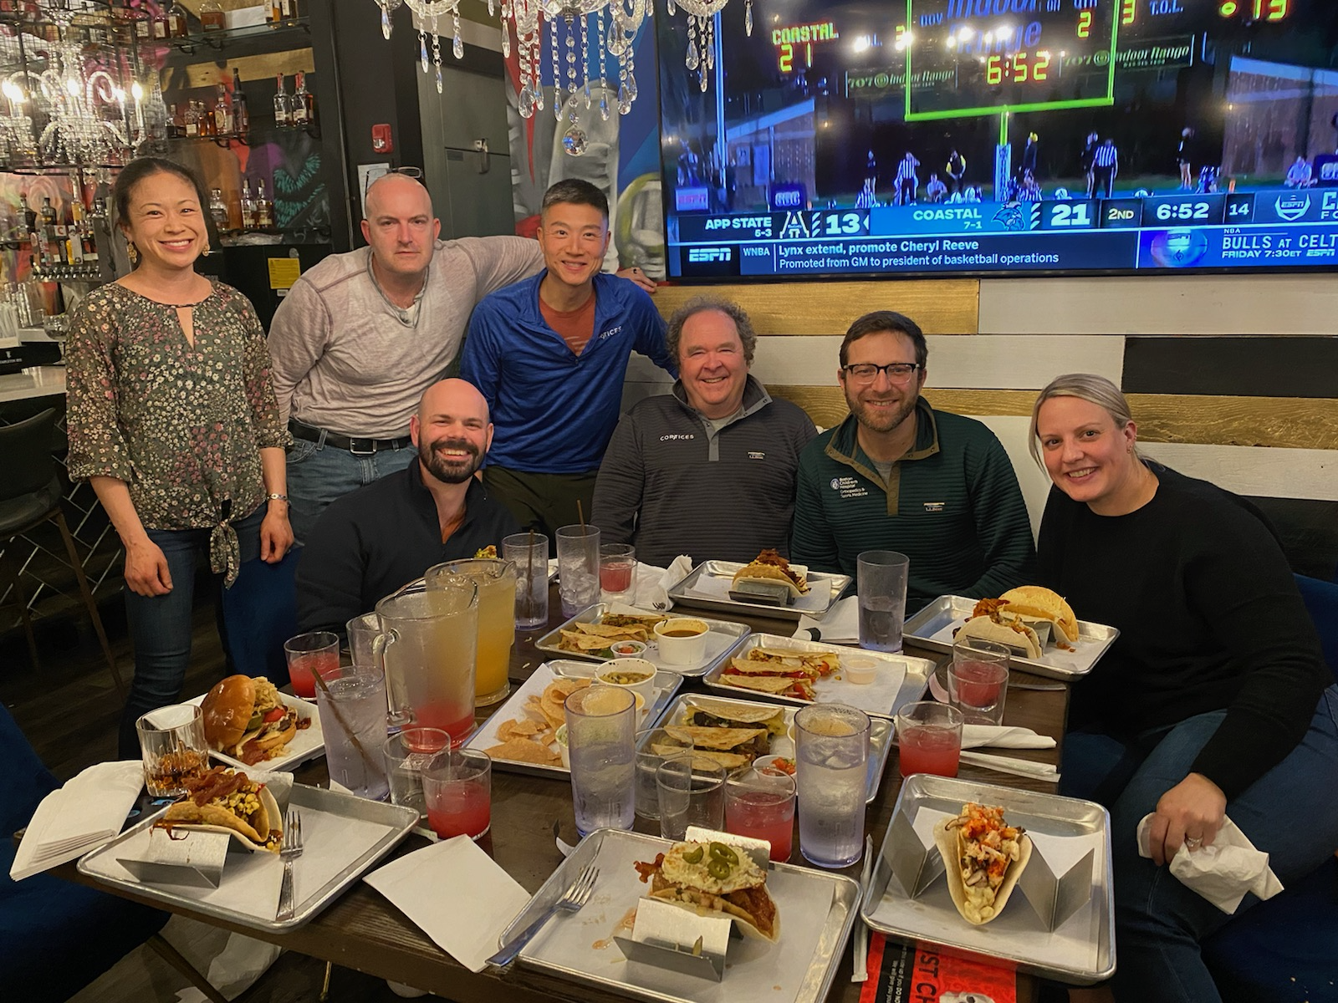
Great to be back together again

Slide 4
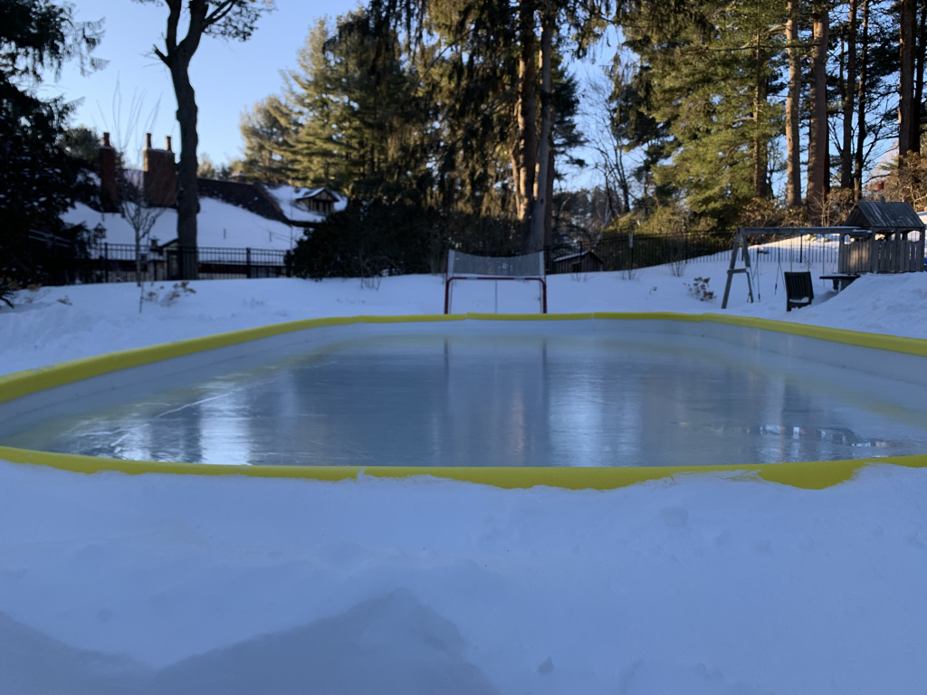
Ice Breaker
Tell us who you are
Where you are working
Where you were born
Guilty pleasure?

Slide 5
Cortices Structure
Manya Bali – Head Research Coordinator
BOD
Executive Committee
Ben Shore, David Spence, Salil Upasani, Ying Li, Jon Schoenecker
Research Committee
Keith Baldwin, Rachel Goldstein, Walter Troung
Membership Committee
Allan Beebe, Jen Laine
Web Site
Megan Johnson
Jaime Rice Denning

Slide 6
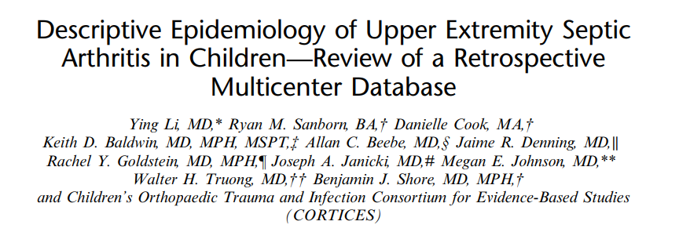
Recent Publications

Slide 7
POSNA Abstract Submissions
Characteristics of Septic Arthritis of the Foot and Ankle in Children – Review of a Retrospective Multicenter Database (Stepanovich)
Knee Septic Arthritis or Lyme Disease – Can It Be Predicted? (Li)
Pediatric Floating Elbow... What is All the Fuss About? A Multicenter Perspective (Zheng/Baldwin)
Comparing Non-Accidental Trauma Protocols Across the US – Not All Are Created Equal (Bali/Rosenfeld)

Slide 8
IRB and DUA Statuses
19/20
CORTICES Registry IRB Master DUA Study Specific Addendum
Some sites only require an SSA for Registry protocol
Some sites need separate SSA for each ancillary study
Floating Elbow
NAT
19/20
11/11
3/5
3/6

Slide 9
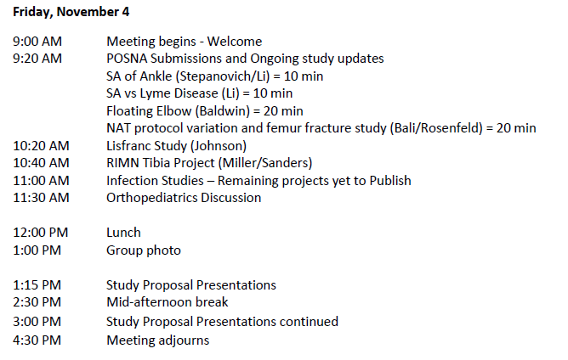
Presentations Timeline

Slide 10
Unfinished Business - Infection
Tier 1 and Tier 2 infection – has still lots of data
Ying has written SA and UE cohorts
Salil has written osteomyelitis paper
But still lots more to do

Slide 11
Unfinished Business - Infection
Tier 1 and Tier 2 infection – has still lots of data

Slide 12
Unfinished Business - Infection

Slide 13
Option 1:
Cortices names 3-5 lead / master collaborators who work directly with OP. These lead collaborators facilitate dialogue and consensus among the Cortices team members. Then, that same team would meet with the OP team, working more intimately on the day in and day out details of said project. The collaborators would ebb and flow between the 2 groups as the intermediary, constantly progressing the ideas and feedback from the Cortices group.
Once said project is completed and launched, a predetermined royalty rate would be paid into Cortices, supplying a quarterly / annualized cash flow to support ongoing Cortices research (and expenses).
Option 2:
Same as above but instead of a royalty arrangement, the Cortices primary collaborators would have Fee For Service Consultative contract, getting paid an hourly rate to collaborate on the said project. We could extend the group size, 5-6 total.
Option 3:
OrthoPediatrics completes said project without any Cortices relationship or affiliation (traditional individual royalty and FFS method)

