Slide 1
CORTICES at POSNA 2023

Slide 2
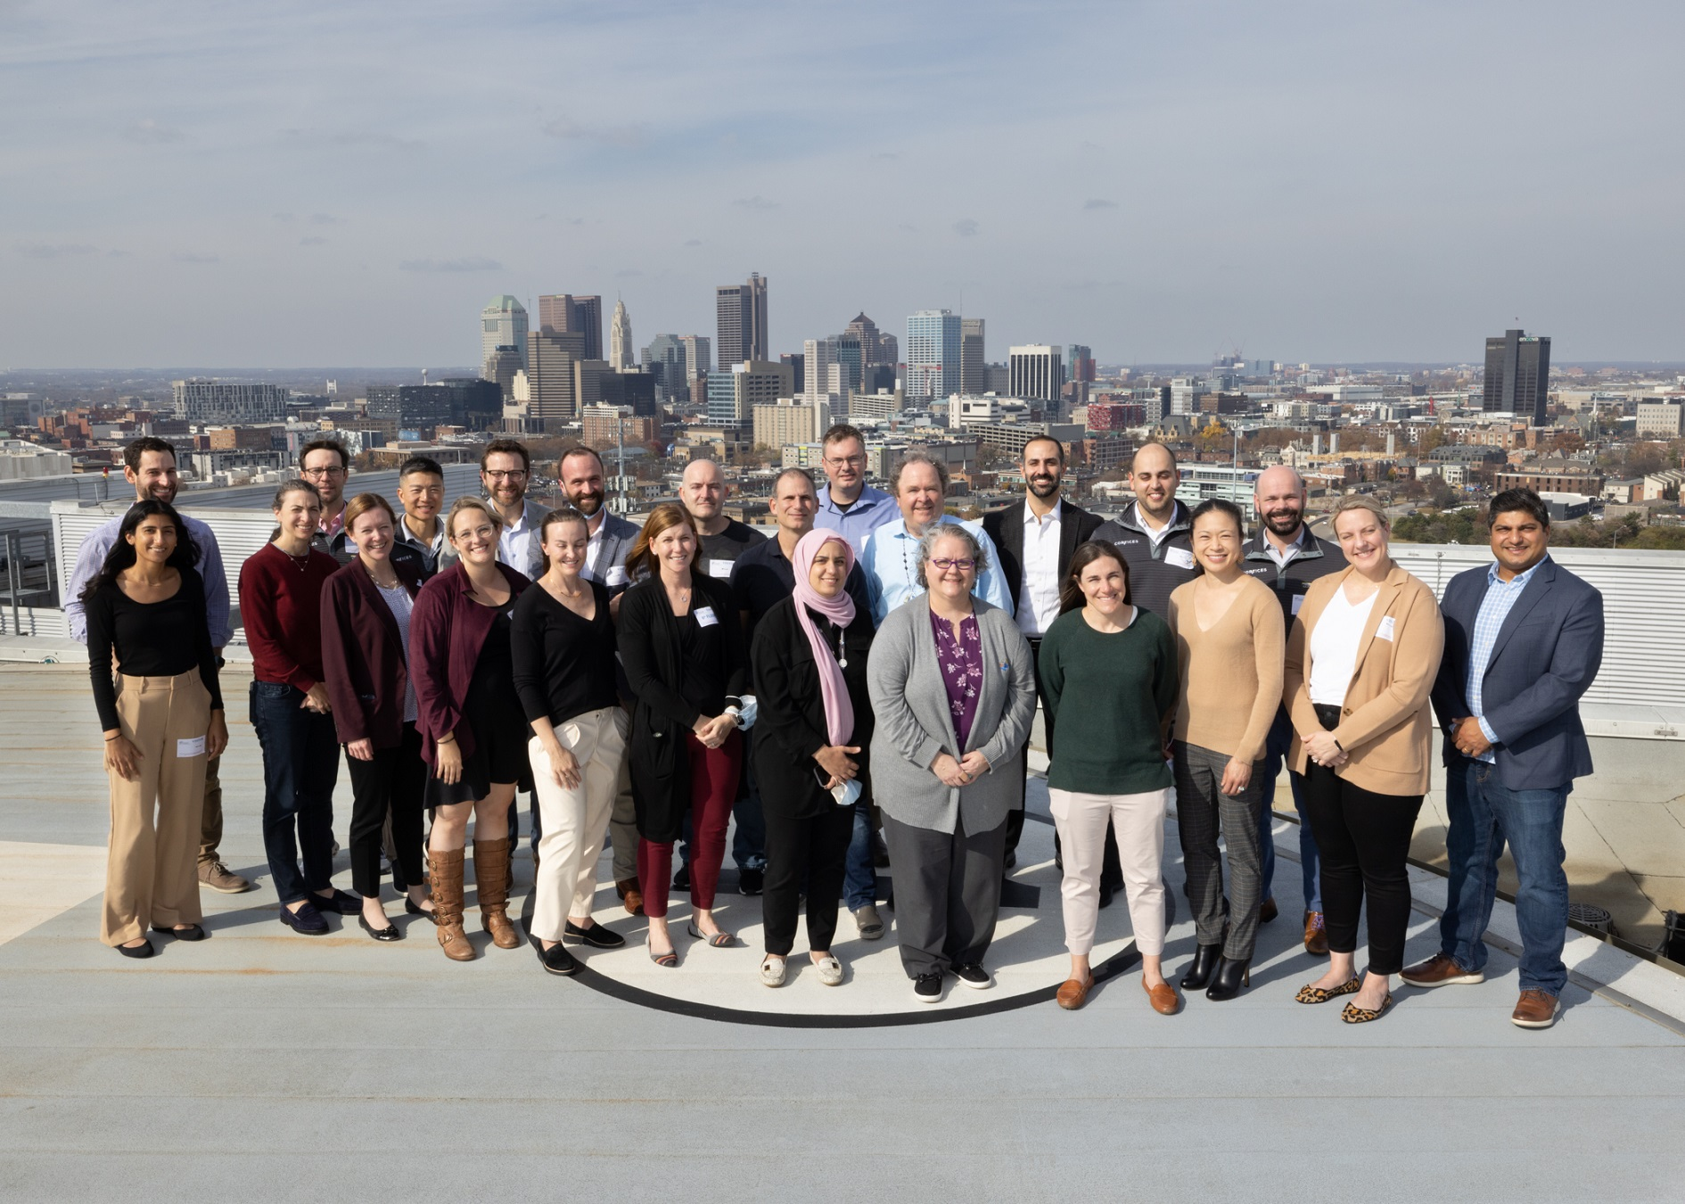
Columbus 2022

Slide 3
Podiums at POSNA 2023
Comparing Non-Accidental Trauma Protocols Across the U.S. – Not All Are Created Equal
Manya Bali; Scott Rosenfeld, MD; Benjamin Shore, MD, MPH, FRCSC
Wednesday, April 26 @ 8:05-8:09 AM - SUBSPECIALTY DAY – TRAUMA
Pediatric Floating Elbows…What is All the Fuss About? A Multicenter Perspective
Jenny Zheng; Jaclyn Hill, MD; Anthony Riccio, MD; Julia Sanders, MD; Allan Beebe, MD; Keith Baldwin, MD; Benjamin Shore, MD, MPH, FRCSC; Rachel Goldstein, MD; Jonathan Schoenecker, MD, PhD; Todd Blumberg, MD; Ying Li, MD; Ishaan Swarup, MD; David Spence, MD; Kathleen Rickert, MD; Jaime Rice Denning, MD, MS
Wednesday, April 26th @ 2:45-2:49 PM - GENERAL SESSION I: TRAUMA & QUALITY, SAFETY, AND VALUE INDICATORS
Characteristics of Septic Arthritis of the Foot and Ankle in Children— Review of a Retrospective Multicenter Database
Matthew Stepanovich, MD; Danielle Cook; Benjamin Shore, MD, MPH, FRCSC; Ying Li, MD
Thursday, April 27 @ 9:34-9:38 AM - GENERAL SESSION III: TUMOR & INFECTION

Slide 4
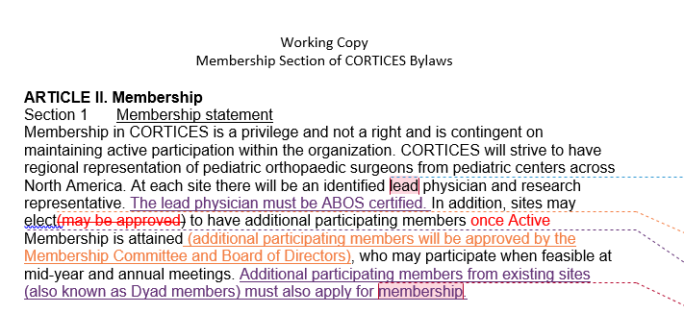
Membership
Changes to bylaws
Points system

Slide 5
Research Interest Groups
Session 1: Open Fracture and Necrotizing Fasciitis
12:30-1:10 PM
Presentations 1:10-1:30 PM
Session 2: Tibia Nail and Lisfranc
1:30-2:10 PM
Presentations 2:10-2:30 PM

Slide 6
Pelvic/Acetabular Survey Updates

Slide 7
NAT Femur Fracture 4.19.23
1190 patients across 15 sites
Notes:
Sex: Male: 842, 70.9%, Female: 346, 29.1% (N=1188)
Race: White: 760, 64.0%; Asian: 29, 2.4%; Black or African American: 237, 19.9%; Hispanic or Latino: 38, 3.2%; Native American or Alaskan Native 12, 1.0%; Hawaiian or Pacific Islander 2, 0.2%; Other 62, 5.2%; Refused 16, 1.3%; Missing/not recorded 32, 2.7% (N = 1188)

Slide 8
NAT Femur Fracture 4.19.23
ADI percentiles (N=1180)
Age in months (N=1189)
Minimum | 25th percentile | Median | 75th percentile | Maximum
1 | 25 | 47 | 76 | 100
Minimum | 25th percentile | Median | 75th percentile | Maximum
0.23 | 13.83 | 23.42 | 29.20 | 36
Notes:
ADI: (N=1180)
Minimum
25th percentile
Median
75th percentile
Maximum
1
25
47
76
100
Age at Presentation (months): (N=1189)
Minimum
25th percentile
Median
75th percentile
Maximum
0.23
13.83
23.42
29.20
36

Slide 9
NAT Femur Fracture 4.19.23
10.8% with unknown mechanism of injury (N=1186)
14.6% with NAT Diagnosis (N=1187)
Notes:
128, 10.8% with unknown mechanism of injury (N=1186)
NAT Diagnosis N =1187
Yes (173, 14.6%), No (1014, 85.4%)

Slide 10
NAT Femur Fracture 4.19.23
Was any form of NAT evaluation initiated? (N=1183)
Yes 673, 56.9%, No 510, 43.1%
If no, did the provider document consideration of NAT? (N=509)
Yes 195, 38.3%, No 314, 61.7%
If yes, did the provider determine that the injury was more likely to be accidental? (N=195)
Yes (189, 96.9%), No (6, 3.1%)

Slide 11
Website Changes
Update site locations
New members/bios
BOD Section with roles
Membership application instructions

